Slide 1
Finnish Society of Soil Sciences
Katri Rankinen, Finnish Environment Institute
Pekka Hänninen, Geological Survey of Finland
Helena Soinne, University of Helsinki
Jaana Leppälammi-Kujansuu, University of Helsinki
Tapio Salo, Natural Resources Institute Finland
Taina Pennanen, Natural Resources Institute Finland EGU, 25.4.2017

Slide 2
History of the Finnish Society of Soil Sciences
The Society was established in 1971
The organization of IUSS was renewed to better support national activities in 1998 ->
New start of the Finnish Society of Soil Sciences
Became affiliated to the IUSS
The Federation of Finnish Learned Societies
Travelling money
Web pages
House of Science and Letters

Slide 3
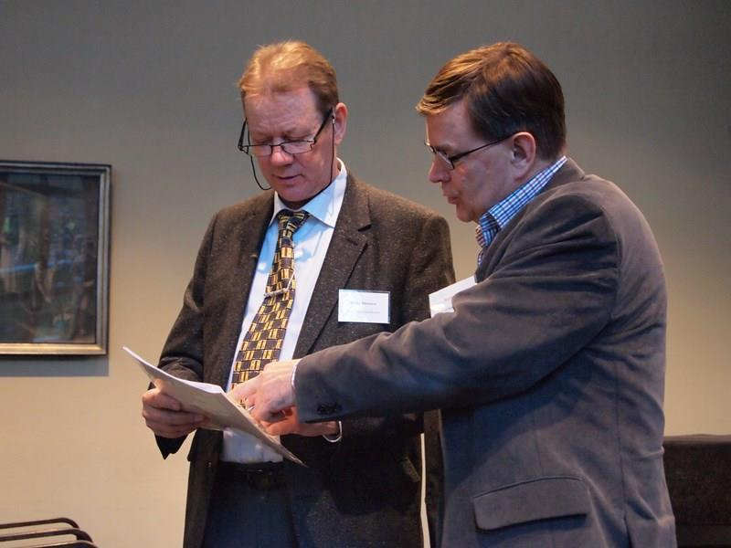
History of the Finnish Society of Soil Sciences
First Chair Martti Esala
Second Chair Pekka Hänninen
Third Chair Helena Soinne (19.4.2017)
The members of the executive board cover different fields of soil science from geology to microbiology
Around 200 members
Student division since 2016

Slide 4
Mission statement of the society
To promote the soil sciences and their application in Finland
To act as a forum for creation of better links between soil scientists, interested end users and the public
To promote distribution and appreciation of general and Finnish research findings in soil science

Slide 5
Action of the Society
Every second year the society organizes a national two-day long conference ‘Maaperätieteiden päivät’
Every second a year longer excursion over week end
Other seminars or events
Dinners
Official Web-pages
Facebook and Twitter

Slide 6
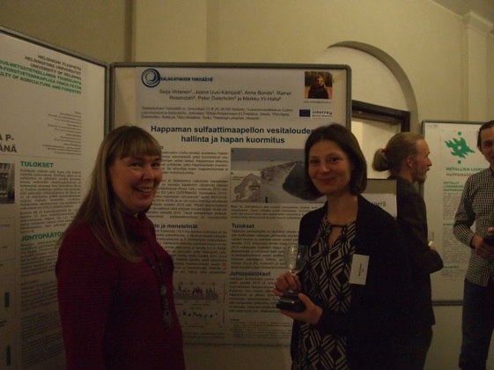
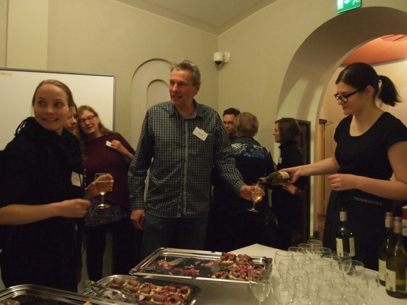
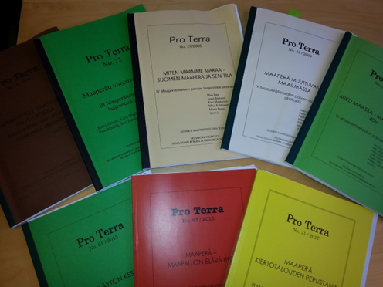
Conference: Maaperätieteiden päivät
Different topics
2017: Circular economy
2015: Soil – Living skin of the Earth
2013: Sustainable land use
No paraller sessions but a lot of time for posters
With good food and drinks
Conference publication
Strongly ’gray’ leaving room for ’a real publication’
New this year
Flash talks
Young chairs

Slide 7
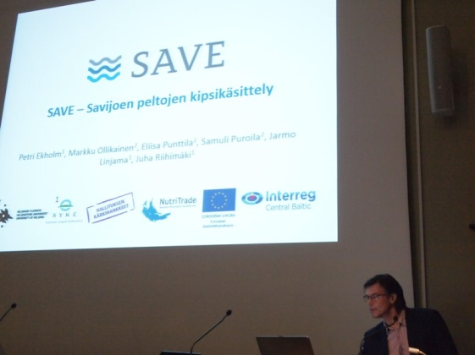
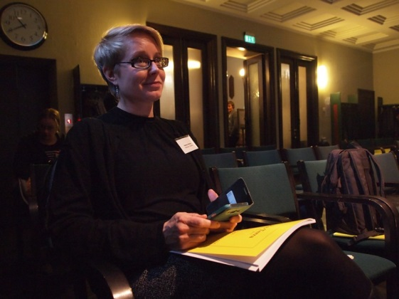
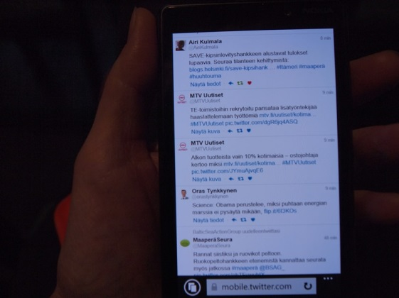
Influence of the Days
Next day an article on the editorial page of the leading newspaper
Very smiling Director General and Research Director in the cafeteria talking with the confused colleague of mine

Slide 8
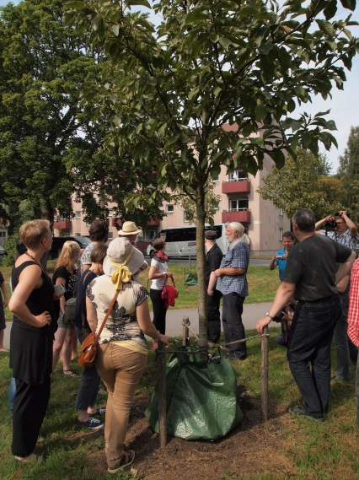
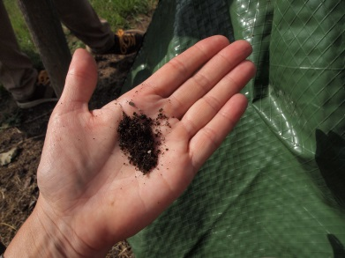
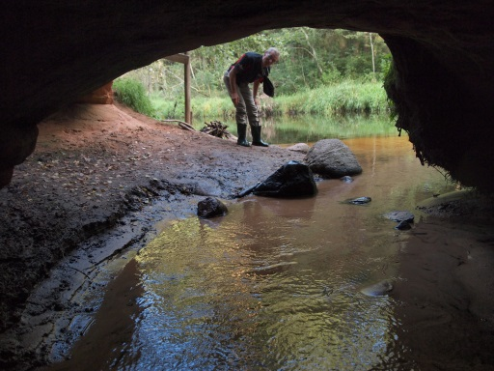
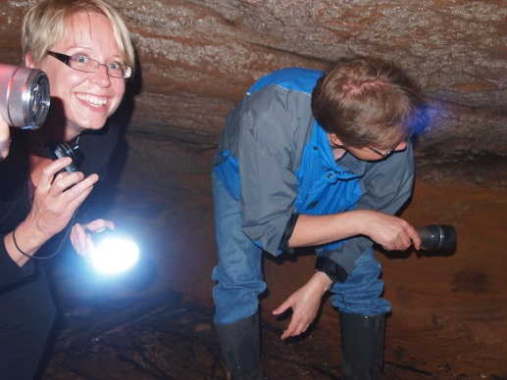
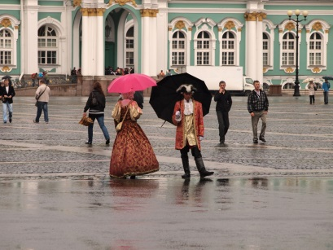
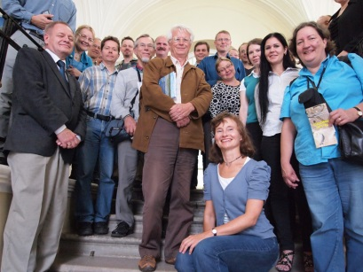
Excursions
Stockholm, Sweden
Use of biochar in town parks
Riga, Latvia
Chalk soils
St. Petersburg, Russia
Excellent soil museum
Tarto, Estonia
Drumlins and other signs of ice age
Pietarsaari, Finland
UNESCO Cultural Heritage: uplift area after ice age

Slide 9
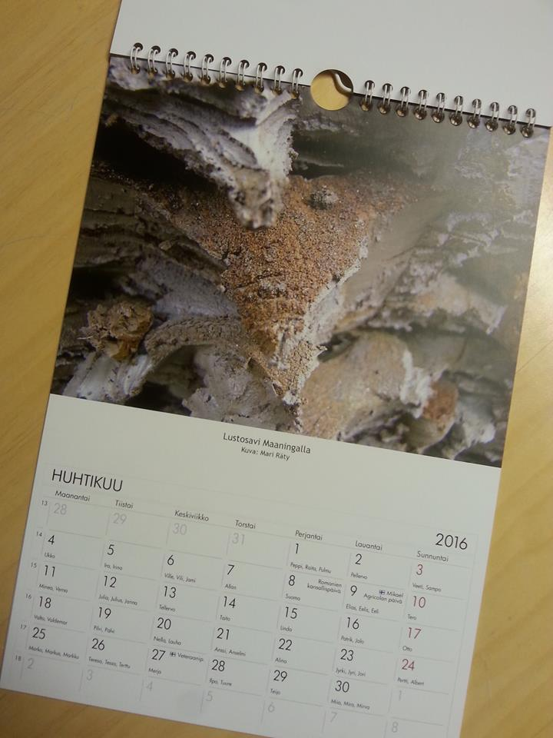
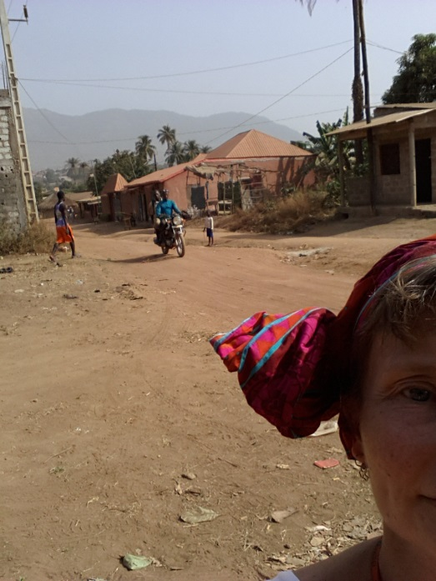
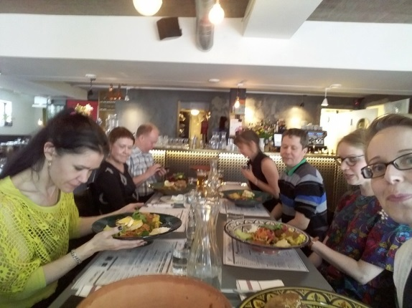
Other activity
Seminars
Seminar 2010 to honor Jouko Vuorinen who eshtablished SMS
Extreme values 2012
2015: The International Year of Soils
Photograph competition
Calendar
Now: Selfie competition ‘Me and Soil’
Dinners twice a year

Slide 10
Web pages and Facebook
Web pages are ’official’ information platform
www.maapera.fi
Rules, addresses etc.
Conferences and courses
Open working places from professors to students
katri.rankinen@environment.fi
Facebook is the ’unofficial’ platform
https://www.facebook.com/maaperatieteidenseura/?ref=page_internal

Slide 11
Social media
Facebook in 14.-20. April 2017

Slide 12
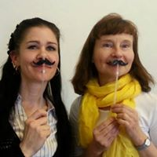
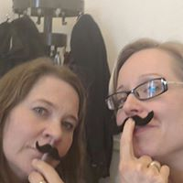
Recipe for success
The Society covers different fields of soil science
We cover different age groups
We keep everything in Finnish (but English is allowed)
We publishe but in ’gray’ paper
We have fun!

Slide 13
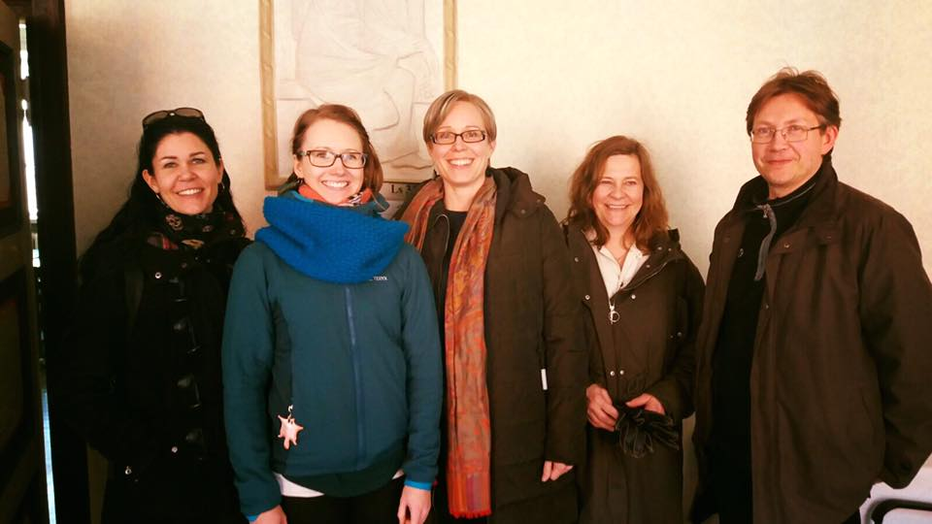
Thank you!
The new board: Jaana Leppälammi-Kujansuu, Noora Manninen, Helena Soinne, Taina Pennanen, Tapio Salo

