Slide 1
Tietoisku: Eurooppalainen ekosysteemiarvio (WG MAES – Mapping and assessment of ecosystems and their services)
Petteri Vihervaara, SYKE/ LK, Helsinki
Erikoistutkija, tutkimuskoordinaattori (Ekosysteemipalvelut)

Slide 2
Background
Launched in April 2012, working until 2020
The objective: to support the implementation of Action 5 by the EU and its Member States
Action 5 of the EU Biodiversity Strategy to 2020 calls Member States to map and assess the state of ecosystems and their services in their national territory with the assistance of the European Commission.
The results of this mapping and assessment should support the maintenance and restoration of ecosystems and their services.
A Working Group on Mapping and Assessment on Ecosystems and their Services (MAES) was set up under the Common Implementation Framework (CIF), the governance structure to underpin the effective delivery of the EU Biodiversity Strategy to 2020.

Slide 3
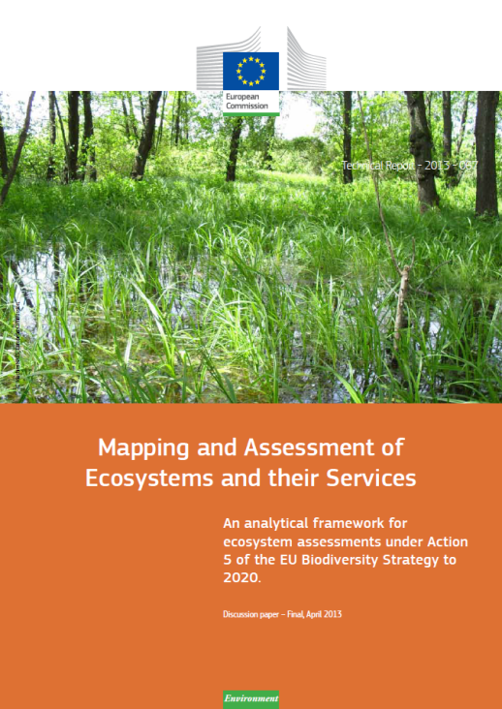
Six pilots so far, three new starting
Nature (Art. 17), Agriculture, Forests, Freshwater, Marine, Natural Capital Accounting
New pilots: Soil, Urban, and Air quality impact
Reporting in BISE, and Digital ES Atlas of EEA
Supporting IPBES

Slide 4
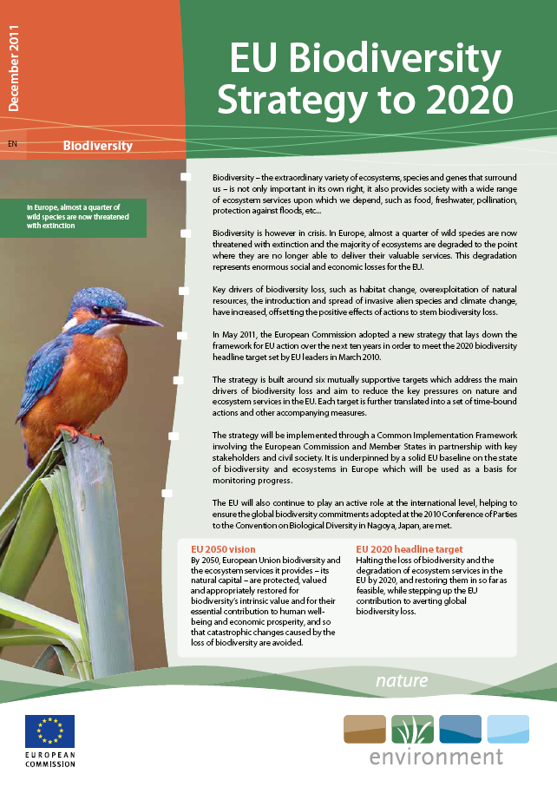
Lisätietoja MAES-työstä:
JRC:n Marmon esitys SOIL PILOTista ja muuta taustamateriaalia:
https://circabc.europa.eu/w/browse/1eda6550-de70-4989-8d0c-f544d56e04a5
ja yleistietoa:
http://biodiversity.europa.eu/maes

